Slide 1
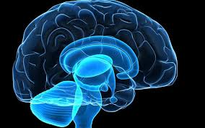
Peer Support & Opioid Use Disorders in 2019
Ralph Dell’Aquila MD, C.C.F.P., M.R.O. ,
American Board of Addiction Medicine
Nurture North MAR Clinic
Northern Ontario School of Medicine
North Bay Regional Health Centre, Dept Family Practice
LERN Callander Sept 18, 2019
Notes:
1

Slide 2
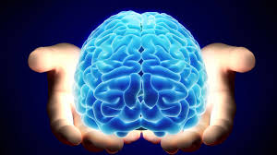
Declaration of Interests
None current
Consultant:
  2013-2016 North Shore Tribal Council
  PAMHAR Program
  2011 Medical Advisory Group workshop Reckitt Benckiser
Notes:
INTRODUCTION:
This is not Addiction 101 for Beginners.
More like Intermediate Addiction.
I am assuming audience knows definitions, etc of
Dependency, Addiction
Save time, plus bored of same old lecture
More interesting to bring up frustrations, challenging cases etc
Pls no time for ranting. Keep it constructive & solution-seeking
If there are beginners, pls
Read it. If don’t understand please ask during Q&A
Please don’t be shy. No one will ridicule.

Slide 3
QUESTIONS
What are the current challenges with Opioid Use Disorders (OUD) in our communities? Solutions?
What are health system challenges?
What are Peer Support strengths?
What are the possible challenges facing PSI? Strengths?
How can PSI best support their members? Their communities?
What role can Peer Support Initiatives (PSI) play in addressing OUD in our communities?
Shared Knowledge, Understanding, Insights & Wisdom
  Wellness & Behavioural health
  Losing our Wellness
  Recovering Wellness
Notes:
Stages of Change Model (Transtheoretical) (Proshka and Diclemente)Theory explaining a change process which inspired a treatment approach called Motivational Interviewing. Strategic approaches and style designed to assist people in moving through the stages
Not linear, clients can and will move through the stages at their own pace and may move backwards at times (eg times of high stress)

Slide 4
1. What are the current challenges in OUD?
Fentanyl: Increasing availability, potency, OD deaths
Polysubstance use: crystal meth
MHA: Socio-economic effects in communities
System response to dynamic situation (4 pillars)
The need for different paradigms
What are the solutions?
Notes:
Stages of Change Model (Transtheoretical) (Proshka and Diclemente)Theory explaining a change process which inspired a treatment approach called Motivational Interviewing. Strategic approaches and style designed to assist people in moving through the stages
Not linear, clients can and will move through the stages at their own pace and may move backwards at times (eg times of high stress)

Slide 5
2. Health System Challenges
The 8 strengths of illicit systems
Awareness (of your product/service)
Attractiveness (custom fit)
Available
Accessible
Engaging
Efficient
Effective
Enduring (Retention)
Notes:
Stages of Change Model (Transtheoretical) (Proshka and Diclemente)Theory explaining a change process which inspired a treatment approach called Motivational Interviewing. Strategic approaches and style designed to assist people in moving through the stages
Not linear, clients can and will move through the stages at their own pace and may move backwards at times (eg times of high stress)

Slide 6
3. What are the PSI strengths?
FOUR A’s & E’s
User friendly programming tailored to dynamic needs
Dynamic & Nimble (minimal red tape; quickly identify & address community gaps)
Empathy & truly client-centred
Builds recovery capital
Builds psychological fitness
Builds social fitness
Leaps across health, social & employment sectors
Client Empowerment
Notes:
Stages of Change Model (Transtheoretical) (Proshka and Diclemente)Theory explaining a change process which inspired a treatment approach called Motivational Interviewing. Strategic approaches and style designed to assist people in moving through the stages
Not linear, clients can and will move through the stages at their own pace and may move backwards at times (eg times of high stress)

Slide 7
4. What are the PSI challenges?
Lack of community awareness/understanding of PSI?
Marginalization/stigma? Recognition of effectiveness?
Silos. Need for further cross-sector collaboration? Scope of practice.
Demonstrating evidence of efficacy
Strengthening financial models by diversifying revenues
Notes:
Stages of Change Model (Transtheoretical) (Proshka and Diclemente)Theory explaining a change process which inspired a treatment approach called Motivational Interviewing. Strategic approaches and style designed to assist people in moving through the stages
Not linear, clients can and will move through the stages at their own pace and may move backwards at times (eg times of high stress)

Slide 8
5. How can PSI best support their members?
Assess and respond to changing community needs & gaps
Ongoing agency skill-building (building capacity & capability)
Strengthen community connections for knowledge exchange and improving results-based efficacy
Recruit & engage more members by improving awareness & stigma
Demonstrate results to funders
Notes:
Stages of Change Model (Transtheoretical) (Proshka and Diclemente)Theory explaining a change process which inspired a treatment approach called Motivational Interviewing. Strategic approaches and style designed to assist people in moving through the stages
Not linear, clients can and will move through the stages at their own pace and may move backwards at times (eg times of high stress)

Slide 9
6. What role can Peer Support Initiatives (PSI) play in addressing OUD in our communities?
Strong role in Addressing stigma
Leadership role
Education & CPD (Continuous Personal Development)
  MLE (Masters of Lived Experience) from University of Life
  Knowledge Exchange with community partners
Integral part of Multi-disciplinary Care Teams
  Addressing treatment system weaknesses:
  Integrated Peer Support Specialist (Recovery Coach) in an community-based M.A.R. clinic for OUD
Notes:
Stages of Change Model (Transtheoretical) (Proshka and Diclemente)Theory explaining a change process which inspired a treatment approach called Motivational Interviewing. Strategic approaches and style designed to assist people in moving through the stages
Not linear, clients can and will move through the stages at their own pace and may move backwards at times (eg times of high stress)

Slide 10
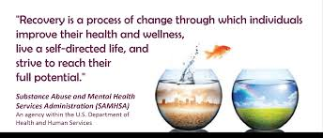
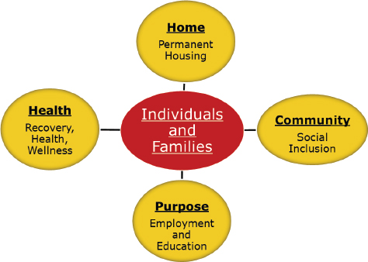
Notes:
Stages of Change Model (Transtheoretical) (Proshka and Diclemente)Theory explaining a change process which inspired a treatment approach called Motivational Interviewing. Strategic approaches and style designed to assist people in moving through the stages
Not linear, clients can and will move through the stages at their own pace and may move backwards at times (eg times of high stress)

Slide 11
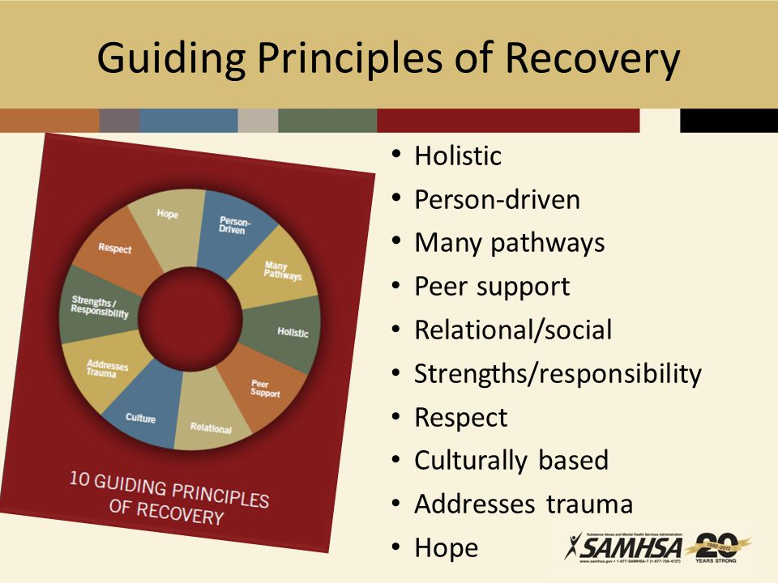
Notes:
Stages of Change Model (Transtheoretical) (Proshka and Diclemente)Theory explaining a change process which inspired a treatment approach called Motivational Interviewing. Strategic approaches and style designed to assist people in moving through the stages
Not linear, clients can and will move through the stages at their own pace and may move backwards at times (eg times of high stress)

Slide 12
Community Treatment of OUD
THE PROBLEM
30% severely ill complex comorbidities
  not in withdrawal, not in recovery
  Medication Assisted Recovery (MAR) clinic: Weaknesses & failures
THE HYPOTHESIS
Can integrating a Recovery Coach in an ORT clinic improve engagement in recovery ?
MEASURING RESULTS & OUTCOMES
Long-term: stabilizing seven healths
Short-term: engagement in BH supports, RTS
Notes:
Stages of Change Model (Transtheoretical) (Proshka and Diclemente)Theory explaining a change process which inspired a treatment approach called Motivational Interviewing. Strategic approaches and style designed to assist people in moving through the stages
Not linear, clients can and will move through the stages at their own pace and may move backwards at times (eg times of high stress)

Slide 13
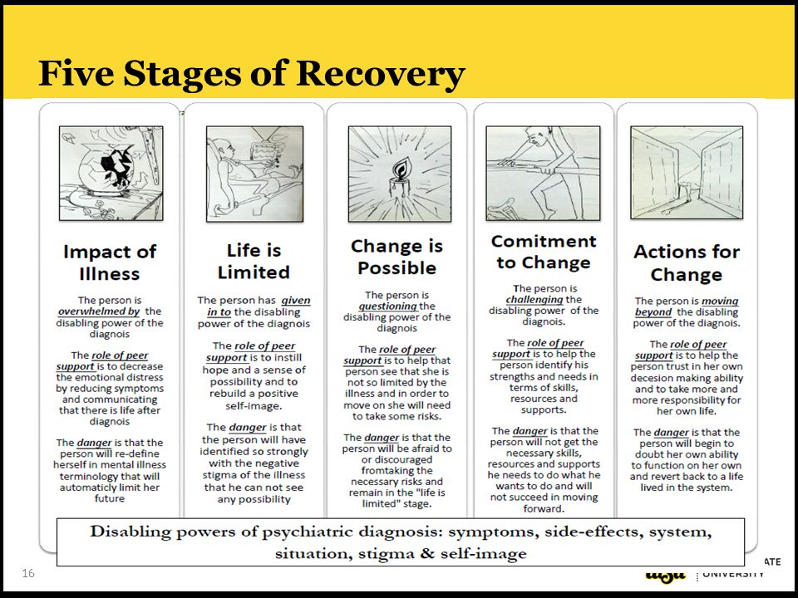
Notes:
Stages of Change Model (Transtheoretical) (Proshka and Diclemente)Theory explaining a change process which inspired a treatment approach called Motivational Interviewing. Strategic approaches and style designed to assist people in moving through the stages
Not linear, clients can and will move through the stages at their own pace and may move backwards at times (eg times of high stress)

Slide 14
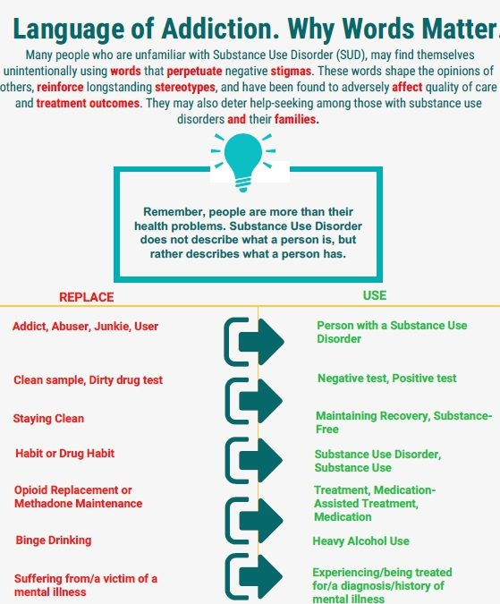
Notes:
Stages of Change Model (Transtheoretical) (Proshka and Diclemente)Theory explaining a change process which inspired a treatment approach called Motivational Interviewing. Strategic approaches and style designed to assist people in moving through the stages
Not linear, clients can and will move through the stages at their own pace and may move backwards at times (eg times of high stress)

Slide 15
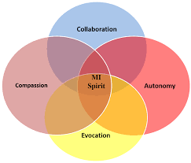
Motivational Interviewing
A collaborative, goal-oriented style of communication
Particular attention to language of change
strengthen personal motivation
and commitment to a specific goal
by eliciting and exploring the person’s own reasons for change
Within a non-judgemental atmosphere of acceptance and compassion
Notes:
Stages of Change Model (Transtheoretical) (Proshka and Diclemente)Theory explaining a change process which inspired a treatment approach called Motivational Interviewing. Strategic approaches and style designed to assist people in moving through the stages
Not linear, clients can and will move through the stages at their own pace and may move backwards at times (eg times of high stress)

Slide 16
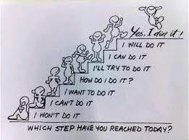

Slide 17
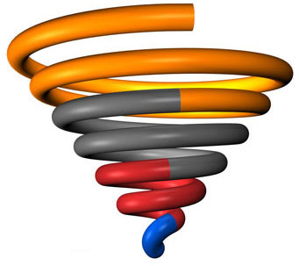
ABSTINENT
LOW RISK USE
HIGH RISK
USE
PROBLEMATIC
USE
USE DISORDER
Notes:
Stages of Change Model (Transtheoretical) (Proshka and Diclemente)Theory explaining a change process which inspired a treatment approach called Motivational Interviewing. Strategic approaches and style designed to assist people in moving through the stages
Not linear, clients can and will move through the stages at their own pace and may move backwards at times (eg times of high stress)

Slide 18
Integrating Addiction Recovery Support Services with Professional Systems of Care
ORT Peer Support Specialist (Recovery Coach)
peers sharing the lived experience of addiction and recovery — are increasingly being integrated into treatment teams
can serve as a cost-effective treatment component
promotes recovery by removing barriers and obstacles to recovery
serves as a personal guide and mentor for people seeking or already in recovery
https://rizema.org/wp-content/uploads/2019/01/UMass-Recovery-Coach-Report.pdf
Addictionrecoverytraining.org
Notes:
Stages of Change Model (Transtheoretical) (Proshka and Diclemente)Theory explaining a change process which inspired a treatment approach called Motivational Interviewing. Strategic approaches and style designed to assist people in moving through the stages
Not linear, clients can and will move through the stages at their own pace and may move backwards at times (eg times of high stress)

Slide 19
Peer Support Navigator (Recovery Coach)
Peer-based recovery support is:
the process of giving and receiving non-professional,
non-clinical assistance to achieve long-term recovery
from severe alcohol and/or other drug-related problems.
This support is provided by people who are experientially credentialed to assist others in :
initiating recovery,
maintaining recovery,
and enhancing the quality of personal and family life in long-term recovery.
William White: Addiction Recovery Support: History,
Theory, Practice and Scientific Evaluation
Notes:
Stages of Change Model (Transtheoretical) (Proshka and Diclemente)Theory explaining a change process which inspired a treatment approach called Motivational Interviewing. Strategic approaches and style designed to assist people in moving through the stages
Not linear, clients can and will move through the stages at their own pace and may move backwards at times (eg times of high stress)

Slide 20
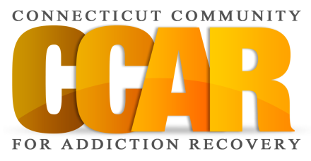

Recovery Coach Roles
(Adapted from William White)
Motivator and Cheerleader
Ally and Confidant
Truth Teller
Role Model and Mentor
Problem Solver
Resource Broker
Advocate
Community Organizer
Addictionrecoverytraining.org

Slide 21
A Recovery Coach Is Not A . . .
(Adapted from William White)
Sponsor
Counselor
Nurse/Doctor
Clergy Person
Addictionrecoverytraining.org

Slide 22
Vermont Recovery Network Report
Service | % Utilizing Before Coaching | % Utilizing After Coaching
Hospital Visit | 36% | 4%
Emergency Room Visit | 38% | 8%
Detox | 38% | 2%
Court Involvement | 58% | 24%
For full report go to: http://vtrecoverynetwork.org/PDF/VRN_RC_eval_report.pdf
https://casatondemand.org/2019/05/29/peer-recovery-support-workers-the-research-says-yes/

Slide 23
Recovery Coaching principles
There are many pathways to recovery.
Focus is on the recovery potential, not the pathology.
Err on the side of the recoveree.
Err on the side of being generous.
It’s about building people so they can build others.
www.williamwhitepapers.com
White, William L. (2007). Ethical Guidelines for the Delivery of Peer-based Recovery Support Services (PDF). PRO ACT Ethics Workshop.
White, W. (March 22–23, 2004). The history and future of peer-based addiction recovery support services (PDF). SAMHSA Consumer and Family Direction Initiative 2004 Summit. Washington, DC.
Notes:
Stages of Change Model (Transtheoretical) (Proshka and Diclemente)Theory explaining a change process which inspired a treatment approach called Motivational Interviewing. Strategic approaches and style designed to assist people in moving through the stages
Not linear, clients can and will move through the stages at their own pace and may move backwards at times (eg times of high stress)

Slide 24

describes the connection between behaviors and the health and well-being of the body, mind and spirit.
This would include how behaviors like eating habits, drinking or exercising impact physical or mental health.
Notes:
Stages of Change Model (Transtheoretical) (Proshka and Diclemente)Theory explaining a change process which inspired a treatment approach called Motivational Interviewing. Strategic approaches and style designed to assist people in moving through the stages
Not linear, clients can and will move through the stages at their own pace and may move backwards at times (eg times of high stress)

Slide 26
BEHAVIOURAL HEALTH (BH)
Behavioural health issues fit in the hierarchy of needs
Behavioural health is a complex interaction of biological, psychological, social & spiritual determinants of health
Maladaptive behaviours are associated with changes in fundamental brain pathways involved in judgement, motivation, reward, executive function, emotional regulation & neurocognition
These changes are often reversible when treated early & well
Comprehensive scientific care & attitudes lead to improved cost-effective results
Healthier community attitudes & approaches improve community health, spirit, identity, & economic development
Notes:
Stages of Change Model (Transtheoretical) (Proshka and Diclemente)Theory explaining a change process which inspired a treatment approach called Motivational Interviewing. Strategic approaches and style designed to assist people in moving through the stages
Not linear, clients can and will move through the stages at their own pace and may move backwards at times (eg times of high stress)

Slide 27
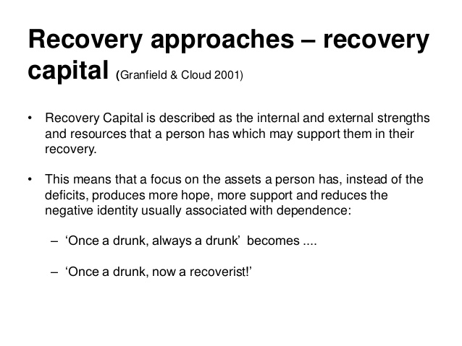
Notes:
Stages of Change Model (Transtheoretical) (Proshka and Diclemente)Theory explaining a change process which inspired a treatment approach called Motivational Interviewing. Strategic approaches and style designed to assist people in moving through the stages
Not linear, clients can and will move through the stages at their own pace and may move backwards at times (eg times of high stress)

Slide 28
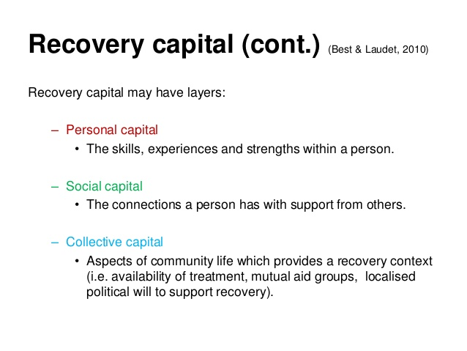
Notes:
Stages of Change Model (Transtheoretical) (Proshka and Diclemente)Theory explaining a change process which inspired a treatment approach called Motivational Interviewing. Strategic approaches and style designed to assist people in moving through the stages
Not linear, clients can and will move through the stages at their own pace and may move backwards at times (eg times of high stress)

Slide 29
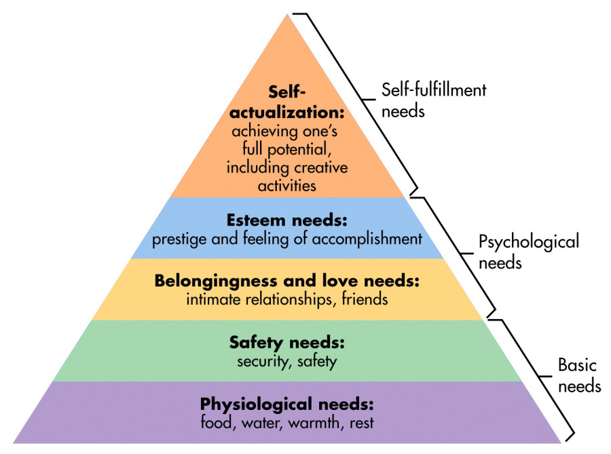
Notes:
Stages of Change Model (Transtheoretical) (Proshka and Diclemente)Theory explaining a change process which inspired a treatment approach called Motivational Interviewing. Strategic approaches and style designed to assist people in moving through the stages
Not linear, clients can and will move through the stages at their own pace and may move backwards at times (eg times of high stress)

Slide 30



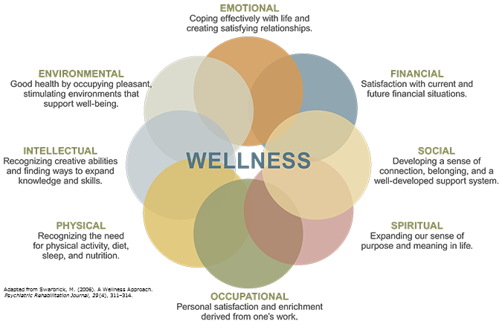
The Domains of HEALTH

Slide 31
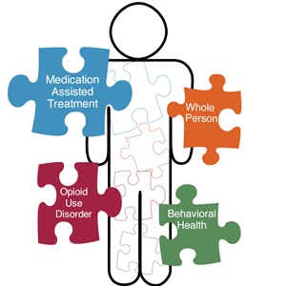
Notes:
INTRODUCTION:
This is not Addiction 101 for Beginners.
More like Intermediate Addiction.
I am assuming audience knows definitions, etc of
Dependency, Addiction
Save time, plus bored of same old lecture
More interesting to bring up frustrations, challenging cases etc
Pls no time for ranting. Keep it constructive & solution-seeking
If there are beginners, pls
Read it. If don’t understand please ask during Q&A
Please don’t be shy. No one will ridicule.

Slide 32
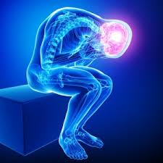
Addiction: a primary, chronic, neurobiological disease, epigenetic, psychosocial, environmental factors often commencing in adolescence
Compulsive use
Craving
Control (loss of)
Consequences (use despite)

Slide 33
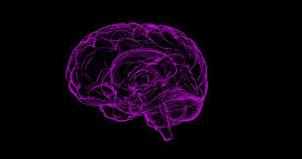
Altered Brain Reward Pathways
Altered NeuroCognition
Altered Motivation
Altered Executive Function
Altered Emotional Regulation
Notes:
INTRODUCTION:
This is not Addiction 101 for Beginners.
More like Intermediate Addiction.
I am assuming audience knows definitions, etc of
Dependency, Addiction
Save time, plus bored of same old lecture
More interesting to bring up frustrations, challenging cases etc
Pls no time for ranting. Keep it constructive & solution-seeking
If there are beginners, pls
Read it. If don’t understand please ask during Q&A
Please don’t be shy. No one will ridicule.

Slide 34
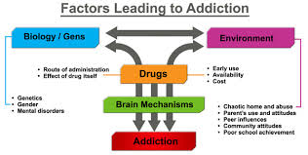
Factors Leading to addiction
Biology/ Genes
Environment
Genetics
Gender
Mental Disorder
Drugs
Brain Mechanism
Addiction
Route of drug Administration
Effect of Drug itself
Early Use
Availability
Cost

Slide 35
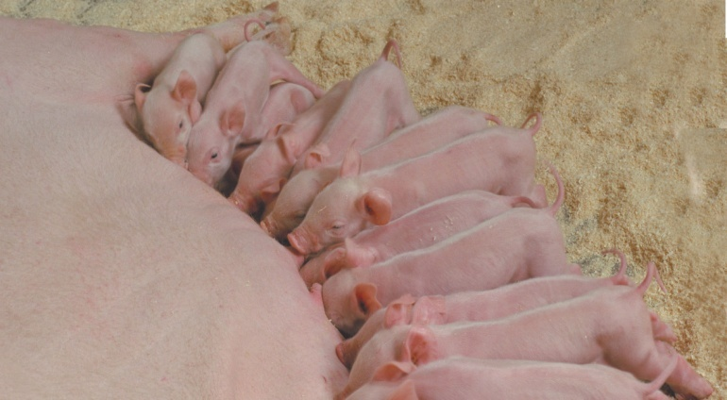


Why does addiction happen?
  Reward-seeking behaviours
  have evolved as a means of
  survival of species
Drugs HIJACK
Brain Reward Circuits
and Motivational Priorities
(dopamine system)
This is why addicts can’t just quit
This is why treatment is essential

Slide 36
Learning Models & Empowerment
Viewing addiction in terms of learning rather than disease may have direct advantages for those who are struggling.
Defining something as a disease does not exempt patients from responsibility for self-care (e.g., making lifestyle choices that improve their prognosis).
A sense of empowerment can bolster self-care for patients with various medical problems.
Viewing oneself as a patient implies that one’s primary duty is to follow the instructions of knowledgeable professionals rather than examine one’s own motivations, beliefs, and intuitions.
Learning Models lead to improving Treatment Outcomes
Notes:
Stages of Change Model (Transtheoretical) (Proshka and Diclemente)Theory explaining a change process which inspired a treatment approach called Motivational Interviewing. Strategic approaches and style designed to assist people in moving through the stages
Not linear, clients can and will move through the stages at their own pace and may move backwards at times (eg times of high stress)

Slide 37




Notes:
Stages of Change Model (Transtheoretical) (Proshka and Diclemente)Theory explaining a change process which inspired a treatment approach called Motivational Interviewing. Strategic approaches and style designed to assist people in moving through the stages
Not linear, clients can and will move through the stages at their own pace and may move backwards at times (eg times of high stress)

Slide 38
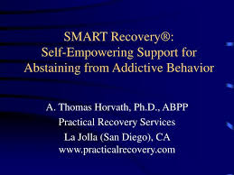

Slide 39
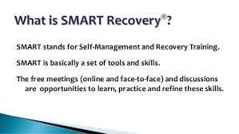

Slide 40
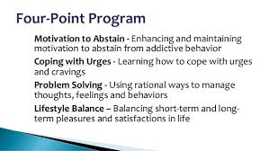

Slide 41

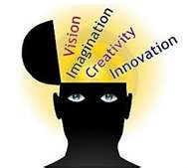
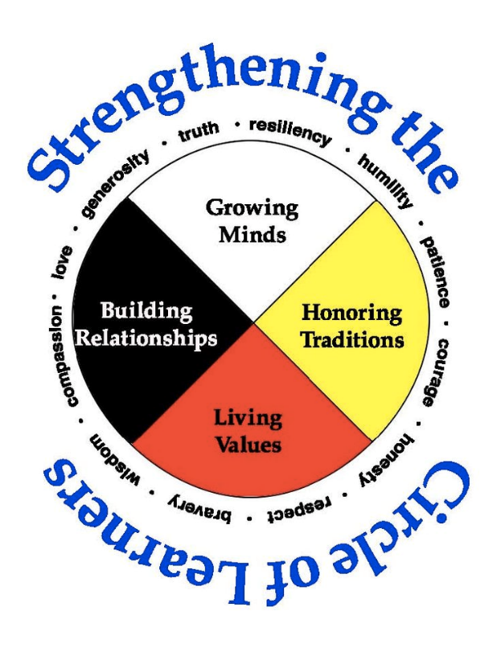
Bridging Gaps in HEALTH, EDUCATION &
PROSPERITY for ALL
  Strength in Cultural Diversity
  Ongoing Community Supports
  Positive Peer Roles
  Employment
  Education & Skills Training
  Behavioural Health TREATMENT 7 healths
  Attract, Motivate Engage in Goals & Vision

Slide 42

Dignity begins when
I feel that
I am
the chief instrument
of change
in my life.
Ralph Dell’Aquila MD, CFPC, ABAM
Notes:
Stages of Change Model (Transtheoretical) (Proshka and Diclemente)Theory explaining a change process which inspired a treatment approach called Motivational Interviewing. Strategic approaches and style designed to assist people in moving through the stages
Not linear, clients can and will move through the stages at their own pace and may move backwards at times (eg times of high stress)

Slide 43

RELATIONSHIPS
ENVIRONMENT
Gathering together
is a beginning;
Keeping together
is progress;
Working together
is success;
Kina gweya n’minobimaadiziwin
Working as one
for the wellbeing of all.
ECONOMIC
SPIRIT
CULTURE
BRAIN
BODY
MIND
R. Dell’Aquila, North Bay 2018
Notes:
Stages of Change Model (Transtheoretical) (Proshka and Diclemente)Theory explaining a change process which inspired a treatment approach called Motivational Interviewing. Strategic approaches and style designed to assist people in moving through the stages
Not linear, clients can and will move through the stages at their own pace and may move backwards at times (eg times of high stress)

