Slide 1
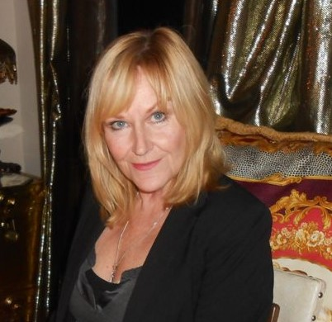
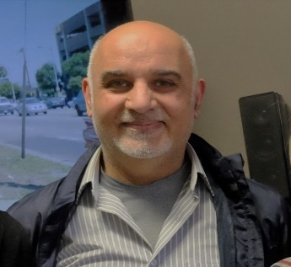


Donnalyn Coyne
Arif Majeed
Jordan Trembley
Peer Directed
Cognitive Behavioural Therapy (CBT)

Slide 2
Agreements and Statements
Personal bill of rights
Privacy and confidentiality policy
Confidentiality agreement

Slide 3

Comfort Agreement.
Switch off mobile devices
Respect
Dignity
Non-Judgmental
No cross talk
Confidentiality
Try to hear what others have to say
Respect others’ gender identity/ pronouns
Self care

Slide 4
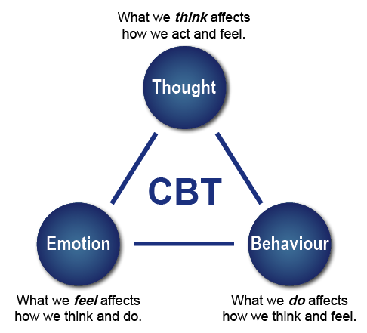
What is Cognitive Behavioural Therapy?
Photo: Stansfield, A. (n.d.). How is this different to Cognitive Behavioural Therapy? Retrieved from http://in8.uk.com

Slide 5
Thoughts are not Feelings
It is important to remember thoughts are NOT feelings
They can be easily confused . The same situation can be interpreted in different ways.
For example, you are shopping at the supermarket.
You are checking the eggs and the carton slips out of your hands.
All of the eggs fall out of the carton – some rolling, others breaking.
  What thoughts would lead you to feel embarrassed?
  What thoughts would lead you to feel indifferent?
  What thoughts would lead you to feel amused?

Slide 6
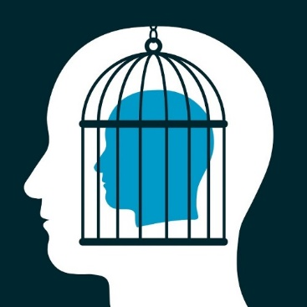
Thinking Traps
There are a number of unhelpful self-statements or thoughts that precede a distressing emotion.
There are common patterns to these thoughts called “thinking traps”
We will go through some common thinking traps.
Pay attention to the ones you commonly use.

Slide 7
Mental Filter
What is it?
  This thinking involves looking at the negative parts of a situation and ignoring the positive parts of the situation
Example
  You have a lovely evening out with your partner. At the end of the evening, you have a disagreement over the tip. You end up only thinking about the disagreement
  Strategies
    Keep a gratitude journal – helps shift your mind towards savoring the positives
    Remember the facts of the whole picture

Slide 8
Jumping to Conclusions / Mindreading
What is it?
  We assume we know what someone else is thinking and we make predictions about what is going to happen in the future
Example:
  You are talking to someone and during the conversation they look at their watch. Perhaps you’ve thought “They must think I am a really boring person”.
Strategy:
  Look at the evidence. What evidence is there to support your conclusion? What is a more balanced, helpful way to look at things

Slide 9
Personalization
What is it?
  Taking 100% responsibility for events that go wrong that you may not be responsible for or only partly responsible for. This style of thinking rarely considers external factors that may be responsible for the event.
Example:
  The toast burned at breakfast and you blame yourself not the toaster.
Strategy:
  Make a responsibility pie chart. Notice what other external factors may be responsible. Break down the situation and you will see you most likely were only partially responsible

Slide 10
Catastrophizing
What is it?
  Assuming the worst-case scenario will happen, blowing things out of proportion, even when the problem is relatively small
Example:
  “I have chest pain. I must be having a heart attack”
Strategies:
  Focus on the evidence or facts of the event, not imaginary consequences
  Ask yourself, what is a more balanced, realistic way of viewing the situation?

Slide 11
Black and White Thinking
What is it?
  Seeing only one extreme or the other. You are either right or wrong, good or bad, and so on.
Example:
  “There is only one winner and the rest are losers”
Strategy:
  Ask yourself, where are the shades of grey in this?

Slide 12
“Should-ing” and “Must-ing”
What is it?
  At times, by saying “I should…” or “I must…” you can put unreasonable demands on yourself and others
Example
  “I should always get things right.” “She should know better than that.”
Strategy
  Try to change your language from I “should” to I “would like to”
  Catch yourself when you are “should-ing” and ask yourself – is this reasonable?

Slide 13
Overgeneralization
What is it?
  Taking one instance in the here and now and imposing it on all future situations. Often includes “all”, “never”, “always” etc.
Example:
  “Things never turn out well for me.” “This is just so typical”.
Strategy:
  Catch yourself using extreme words such as all, never, always, every and change those words to be more specific to the situation “this time”, “right now”, “sometimes” etc.

Slide 14
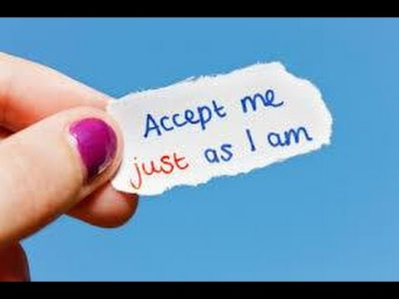
Labelling
What is it?
  We label ourselves when we make global statements based on behaviour in specific situations
Example:
  “I am stupid”. “I am not pretty”. “They are so inconsiderate”.
Strategy:
  Focus on the specific behaviour or event rather than making a statement about the person as a whole. For example, it was inconsiderate of him to leave the house a mess rather than he is inconsiderate.

Slide 15
Emotional Reasoning
What is it?
  You base conclusions based on how you are feeling. In other words, you feel anxious so you think something bad is going to happen.
Example:
  “I feel so depressed. This must be the worst place to work in.”
Strategy:
  Feelings are not facts! They are feelings. They come and they go.
  Look to the evidence and facts of the situation rather than be guided by how you feel.

Slide 16
Magnification and Minimization
What is it?
  You enlarge the positive attributes of other people and shrink the positive attributes of yourself
Example
  “Oh that doesn’t count. I just got lucky”
Strategies
  Give yourself credit! No really, give your self credit.
  Make a “success journal” and note the little successes you achieve daily

Slide 17
Relaxation
Progressive Muscle Relaxation
This technique is to start from your toes and go all the way up to you head - tensing and releasing one muscle group at a time.
When practicing it is important to:
  Differentiate between muscle groups.
  Learn how to both tense and relax muscle groups.
  Practice, practice, practice!

Slide 18
Relaxation
Deep Breathing
The most important thing is to notice when you are holding your breath or are breathing too quickly or shallowly. Once you notice, try the following:
  Timed breathing – breath in for 5 and out for 5 or in for 4, hold for 2 out for 6
  Resistance breathing – add resistance to the exhale by pursing lips, using your nose or using your tongue to restrict air flow
  Meditative breathing – choose a phrase on the inhale (ex. peace) and one on the exhale (ex. love)
Do whichever works for you, It becomes easier with practice!

Slide 19
10 Modules also include the following Topics!
  Self Compassion
  Assertiveness
  Behavioural Activeness
  Cycle of Depression
  Cycle of Anxiety
  Thought Development
  Fear
  Skill Developments

Slide 20
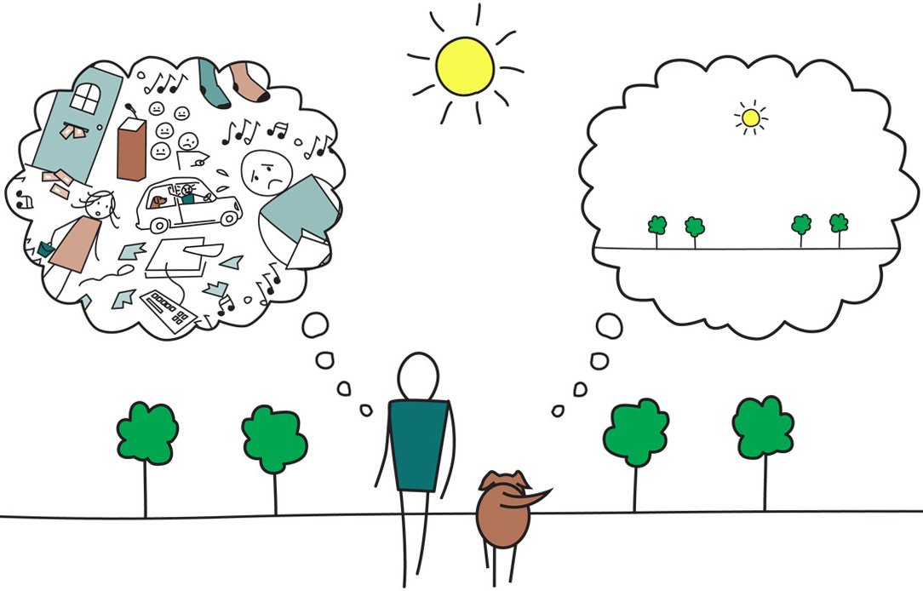
Mindfulness
https://www.youtube.com/watch?v=qzR62JJCMBQ
https://www.youtube.com/watch?v=-2zdUXve6fQ
https://www.youtube.com/watch?v=_iGWdUTifIQ

Slide 21
Next Step!
Participant Workbook
Trainer Manual
Contact- LERN
Experienced PDCBT Facilitator to train your Trainee
Certification for Trainee
Facilitator available for on-going Support
How we Contact each other!
Please contact Arif Majeed at 705-494-4774 ext. 225
Or e-mail: arif.majeed@pepplace.org

Slide 22
“I attended the PDCBT program held at People for Equal Partnership in Mental Health. I learned so many new skills that were practical and enjoyable to apply to every day life. PDCBT helped me recognize my thinking patterns and how to manage my thoughts when things become negative. I learned so much about myself and I feel this group will help me continue to grow.
Our instructor was helpful, honest and inspiring. She always encouraged us to have self acceptance and helped me realize I'm never alone.
This PDCBT program is certainly the most helpful tool I have used throughout my years of trying to cope with my mental health. So happy I got to be a part of this group and I would recommend it to anyone and everyone”.
Testimonials
“This group has taught me show much. I learned lots from my facilitators”
“ I love how we are all given lots of time to share and do the practical assignments. It helps to talk about things that I normally wouldn’t. It also is so healing hearing others struggles and successes”
“I love and enjoyed observing transformation in some of the participants”

Slide 23
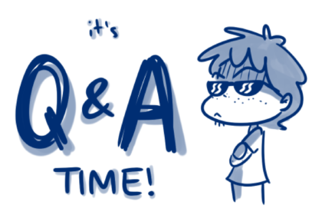

Slide 24

Arif Majeed Jordan Trembley Donnalyn Coyne

